Slide 1
Cancer Center Hub Client (CCHC)
Cancer Center Hub Client
  Inbound lab data may be in comma-delimited (csv) or HL7 version 2 formats
  Data is transformed to HL7 version 3 format by the client using caAdapter
    Mapping of source data to HL7v3 is performed once
  HL7 v3 data is submitted to the caXchange hub, using Grid services and security
  Data is routed to and saved in the Clinical Trials Object Data System (CTODS)

Slide 2
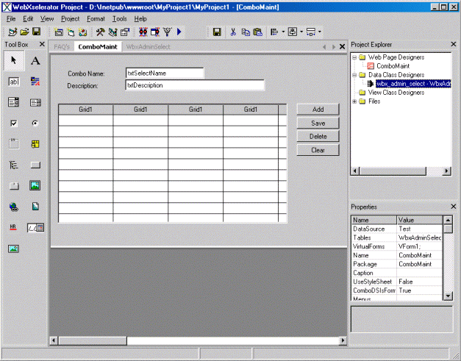
caXchange Cancer Center Hub Client
Study
caAdapter
Dorian
Lookup
Conversion
Patient
Input
Transformed
Grid
Data
File +
Messages
Proxy
Mapping
User
File
Credentials
Grid
Proxy
+
Grid
HUB Client
Messages
Inbound
HUB CLIENT
Responses
Comp.
caXchange
HUB
Input
File
Message
Daemon
Input
Files

